Slide 1
BootChat
By Jingru Ruan
Md

Slide 2


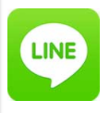



Why?
The purpose of this project is developing
a chatting interface on computer,
providing an alternative chatting
experience from phone to the computer.

Slide 3
Functional Requirements
It will provide a comfortable chatting environment, for user to communicate with each other through this platform.
Authentication: All users need to login to portal first with their ID and password, to use this application.
As a user of the client application, I would like to exchange messages with other client application users.
As a user of the client application, I would like to have a one to one conversation with other client application users.
As a user of the client application, I would like the server to suggest responses based on my previous chat history.
As an administrator of the server, I would like to add and manage users in the system.
As a user of the client application, I would like to have the ability to add users to a contact list.
As a user of the client application, I would like to have the ability to remove users from my contact list.

Slide 4
Non-functional Requirements
Use of client-server model, the client and server using different operation systems and different programming languages(i.e., GO and C#), the server application will use sqlite database to store user information and conversation history.
Client: Windows desktop with C#.net
Server: Linux server with Go language

Slide 5
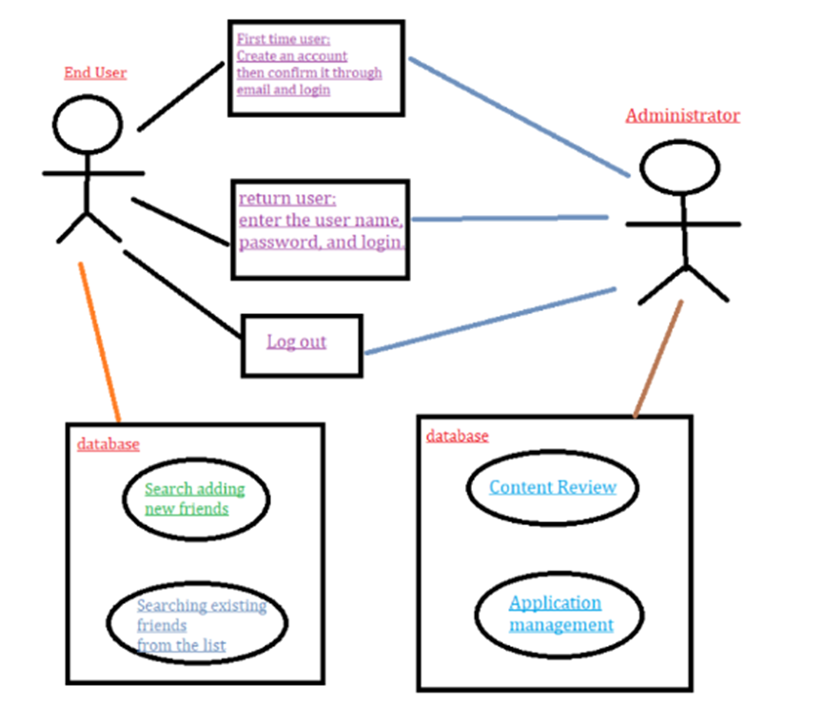
Use-case Model

Slide 6
Questions & Answers

